Slide 1



The impact of nonreciprocal higher-order interactions on synchronization
Luca Gallo

Slide 2
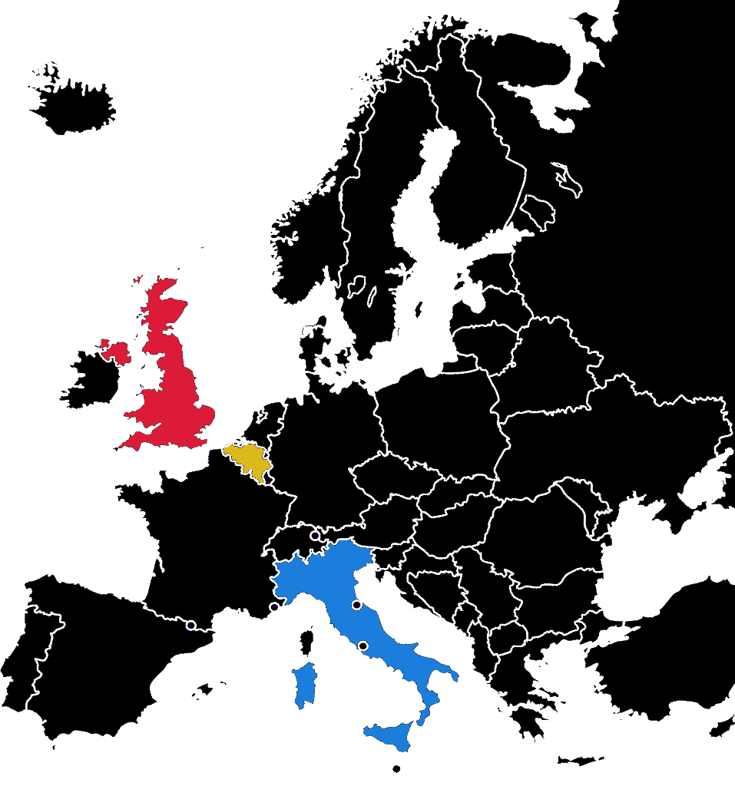





Vito Latora
Timoteo Carletti
Riccardo Muolo
Mattia Frasca
Lucia Valentina Gambuzza

Slide 3

Asymmetrical many-body processes

Slide 4
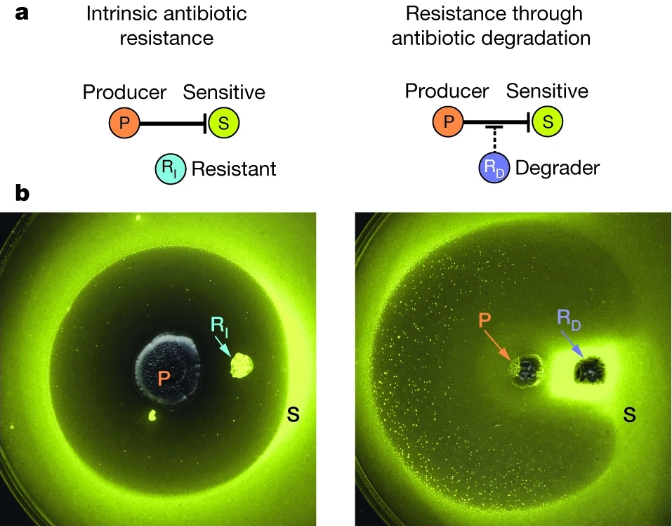
Asymmetrical many-body processes
Kelsic, E.D., Zhao, J., Vetsigian, K., Kishony, R., Nature, 521, 7553 (2017)

Slide 5
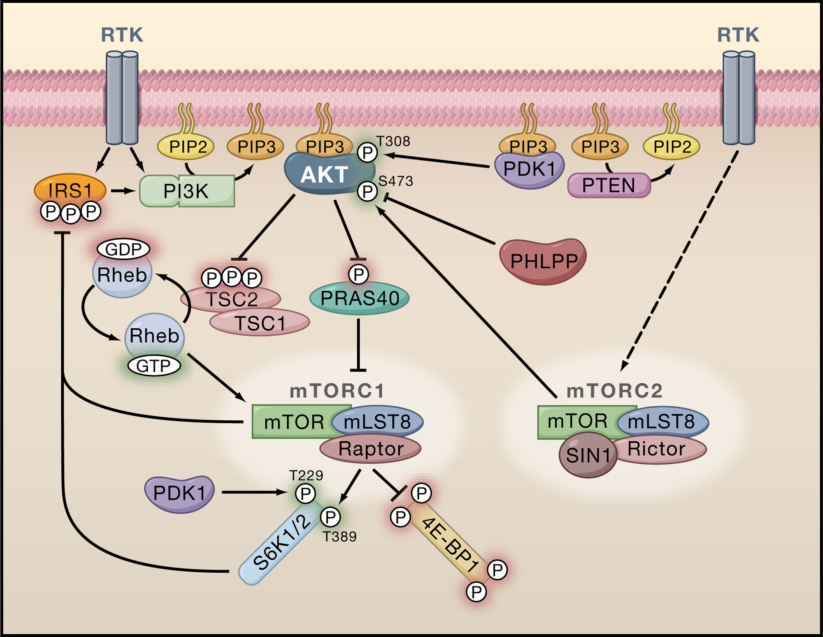
Asymmetrical many-body processes
Manning, B.D., Cantley, L.C., Cell, 129, 7 (2007)
Kelsic, E.D., Zhao, J., Vetsigian, K., Kishony, R., Nature, 521, 7553 (2017)

Slide 6
How can we model dynamical processes in presence of nonreciprocal many-body interactions?

Slide 7
Elementary Decomposition: three-body interactions

Slide 8
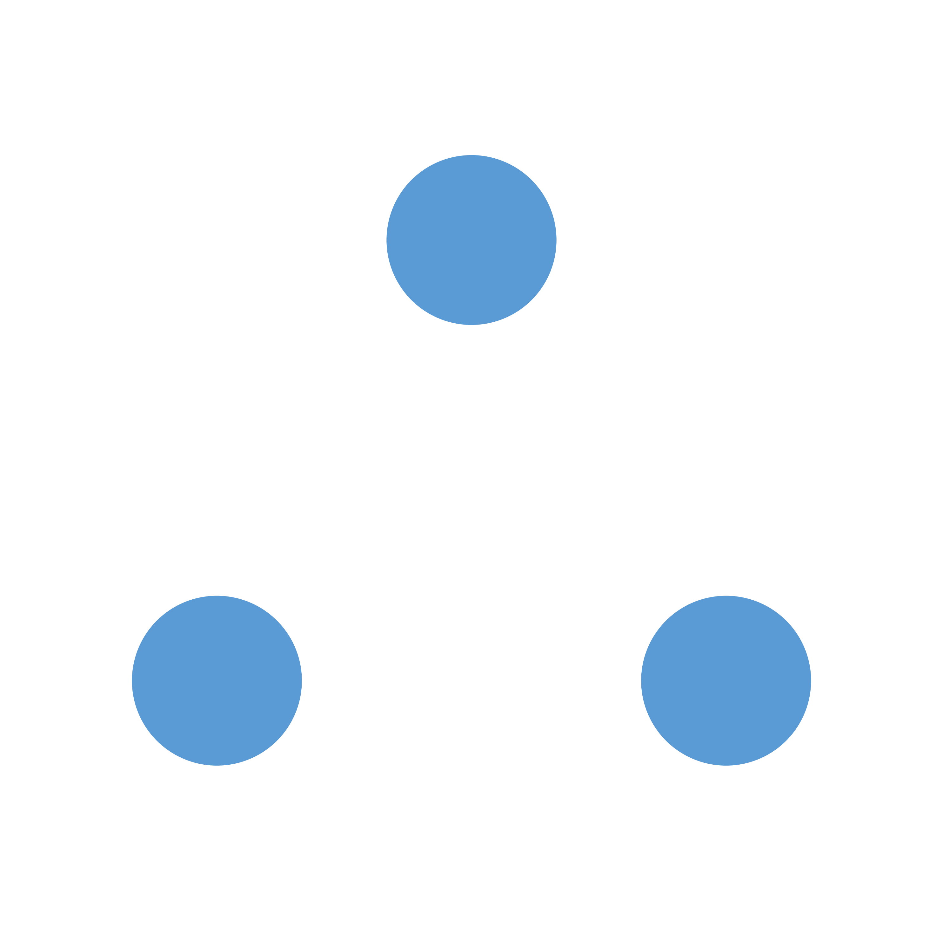
Elementary Decomposition: three-body interactions
k
i
j

Slide 9
Elementary Decomposition: three-body interactions
k
k
k
k
i
j
i
j
i
j
i
j

Slide 10




Elementary Decomposition: three-body interactions
k
k
k
k
i
j
i
j
i
j
i
j

Slide 11



Synchronization: an emergent and ubiquitous phenomenon

Slide 12

Synchronization of rÖssler oscillators with nonreciprocal higher-order interactions

Slide 13

Synchronization of rÖssler oscillators with nonreciprocal higher-order interactions
Local dynamics

Slide 14

Synchronization of rÖssler oscillators with nonreciprocal higher-order interactions
Two-body interactions
Local dynamics

Slide 15

Synchronization of rÖssler oscillators with nonreciprocal higher-order interactions
Two-body interactions
Three-body interactions
Local dynamics

Slide 16
The master stability function approach:
Nonlinear dynamics

Slide 17
The master stability function approach:
Nonlinear dynamics
Linearization around the synchronous state
Linearized dynamics

Slide 18
The master stability function approach:
Nonlinear dynamics
Linearization around the synchronous state
Linearized dynamics
Projection onto the eigenvectors of a Laplacian matrix
Decoupled dynamics

Slide 19
The master stability function approach in directed hypergraphs

Slide 20

The master stability function approach in directed hypergraphs
Nontrivial eigenvalues of

Slide 21

The master stability function approach in directed hypergraphs

Slide 22
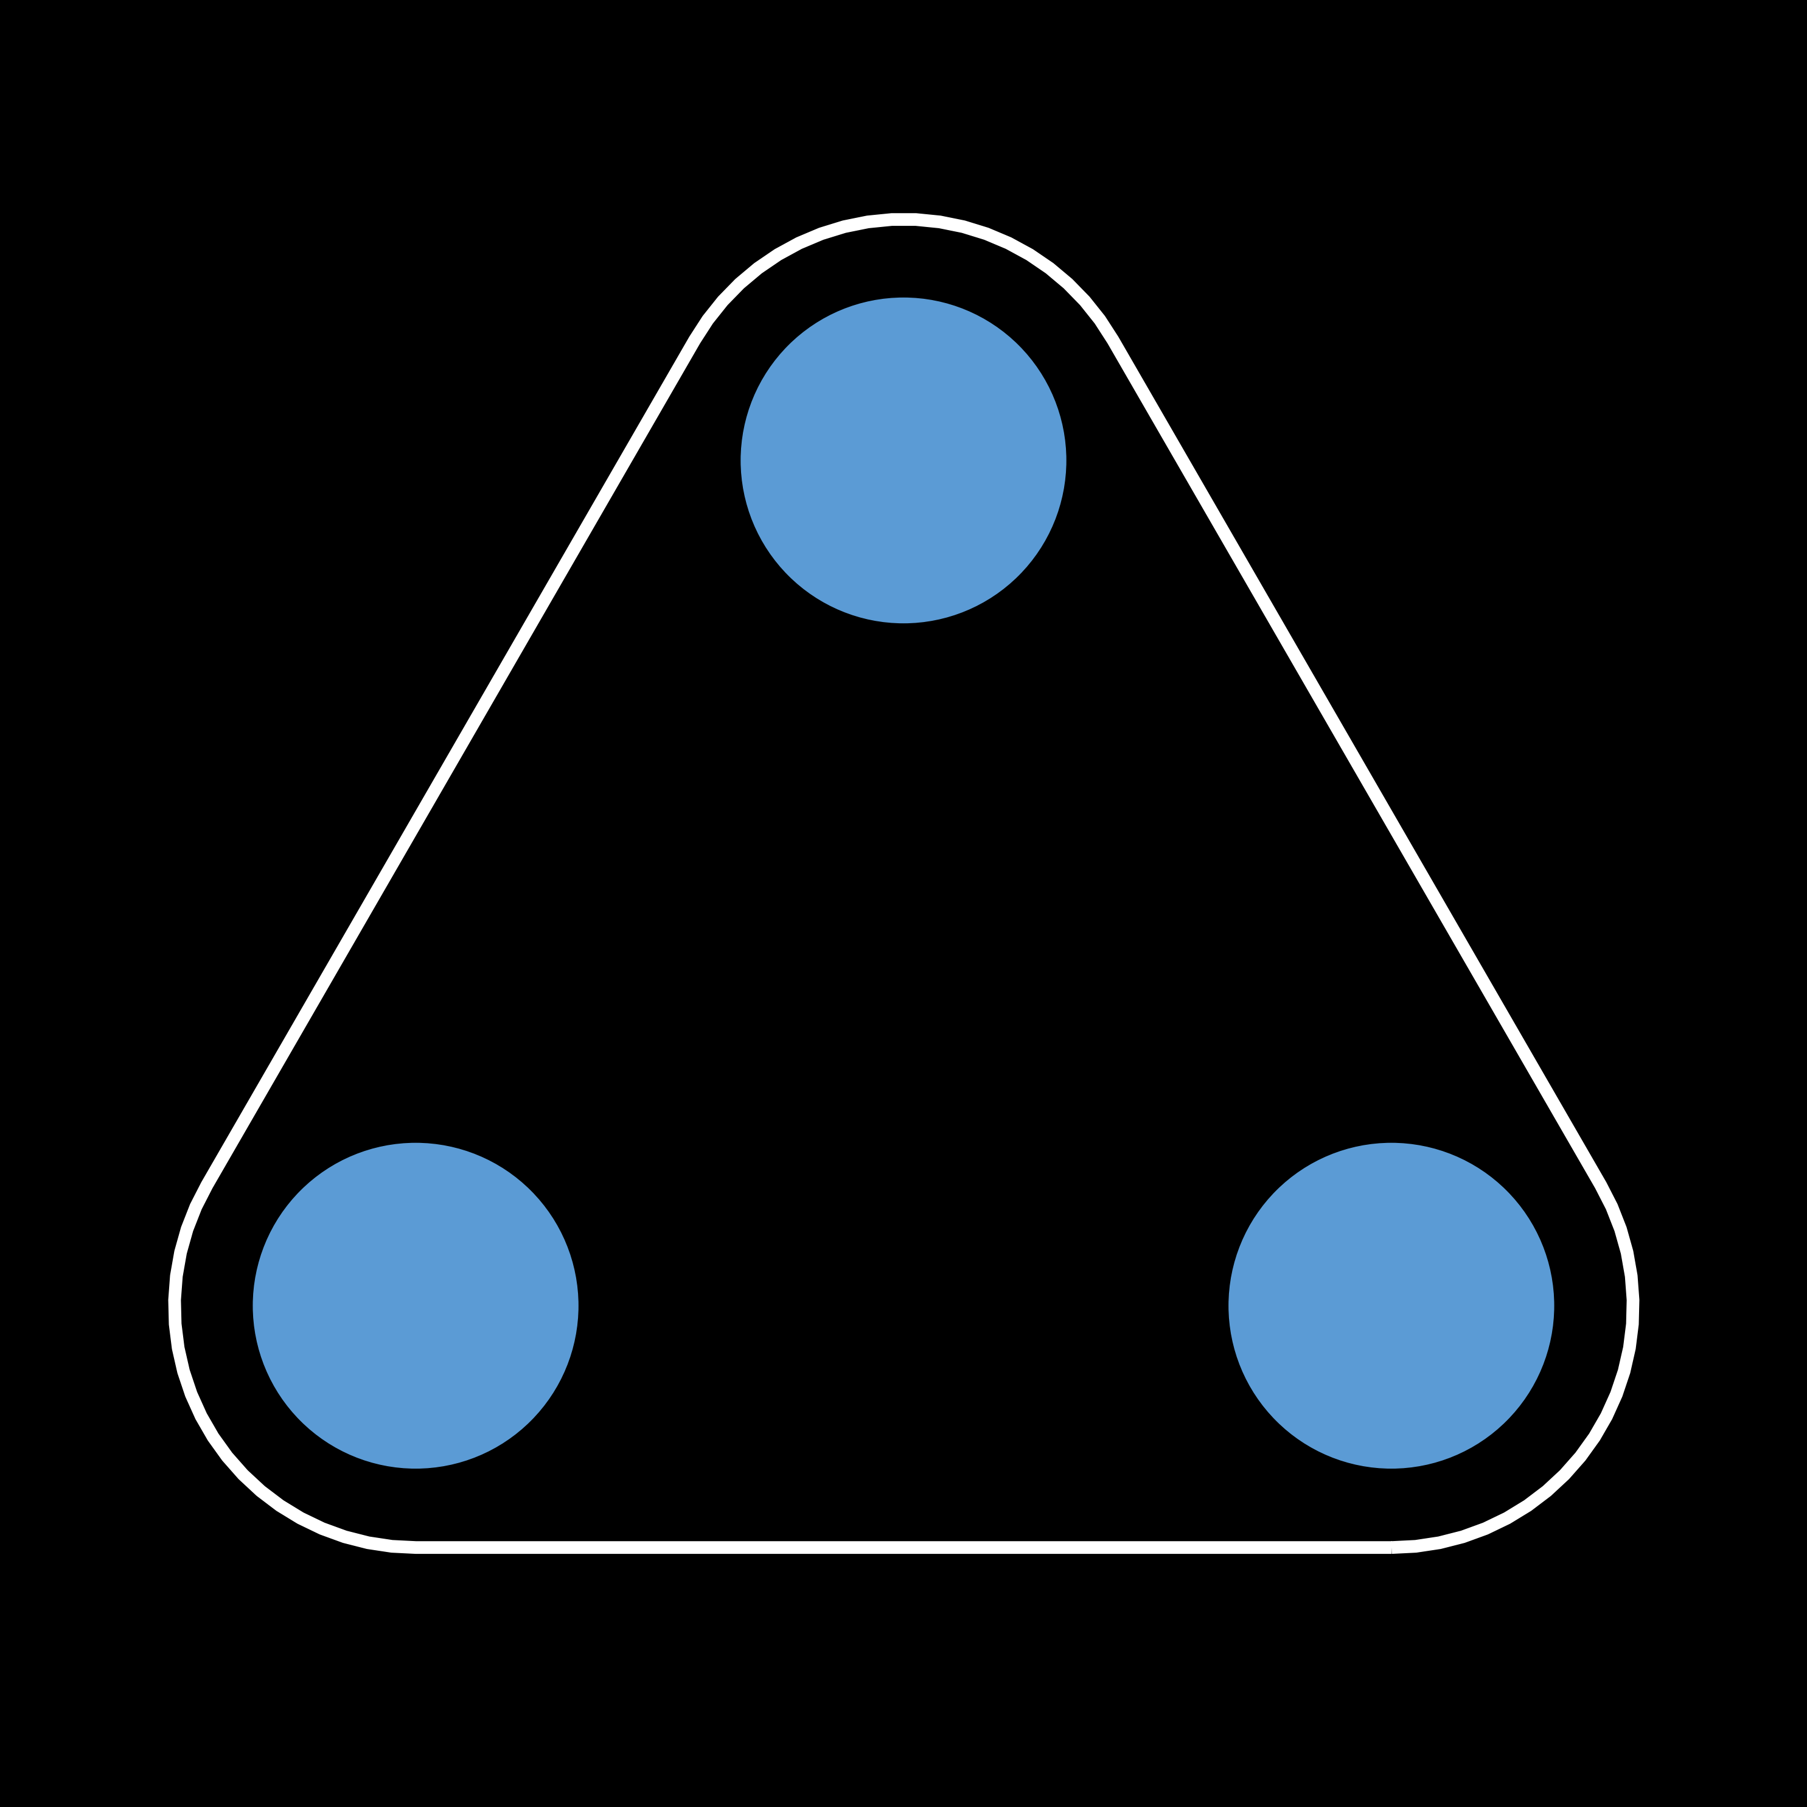
Symmetrization
k
k
k
Directed
p=0
i
j
i
j
i
j

Slide 23
Symmetrization
k
k
k
Directed
p=0
i
j
i
j
i
j
k
k
k
p=1
Undirected
i
j
i
j
i
j

Slide 24
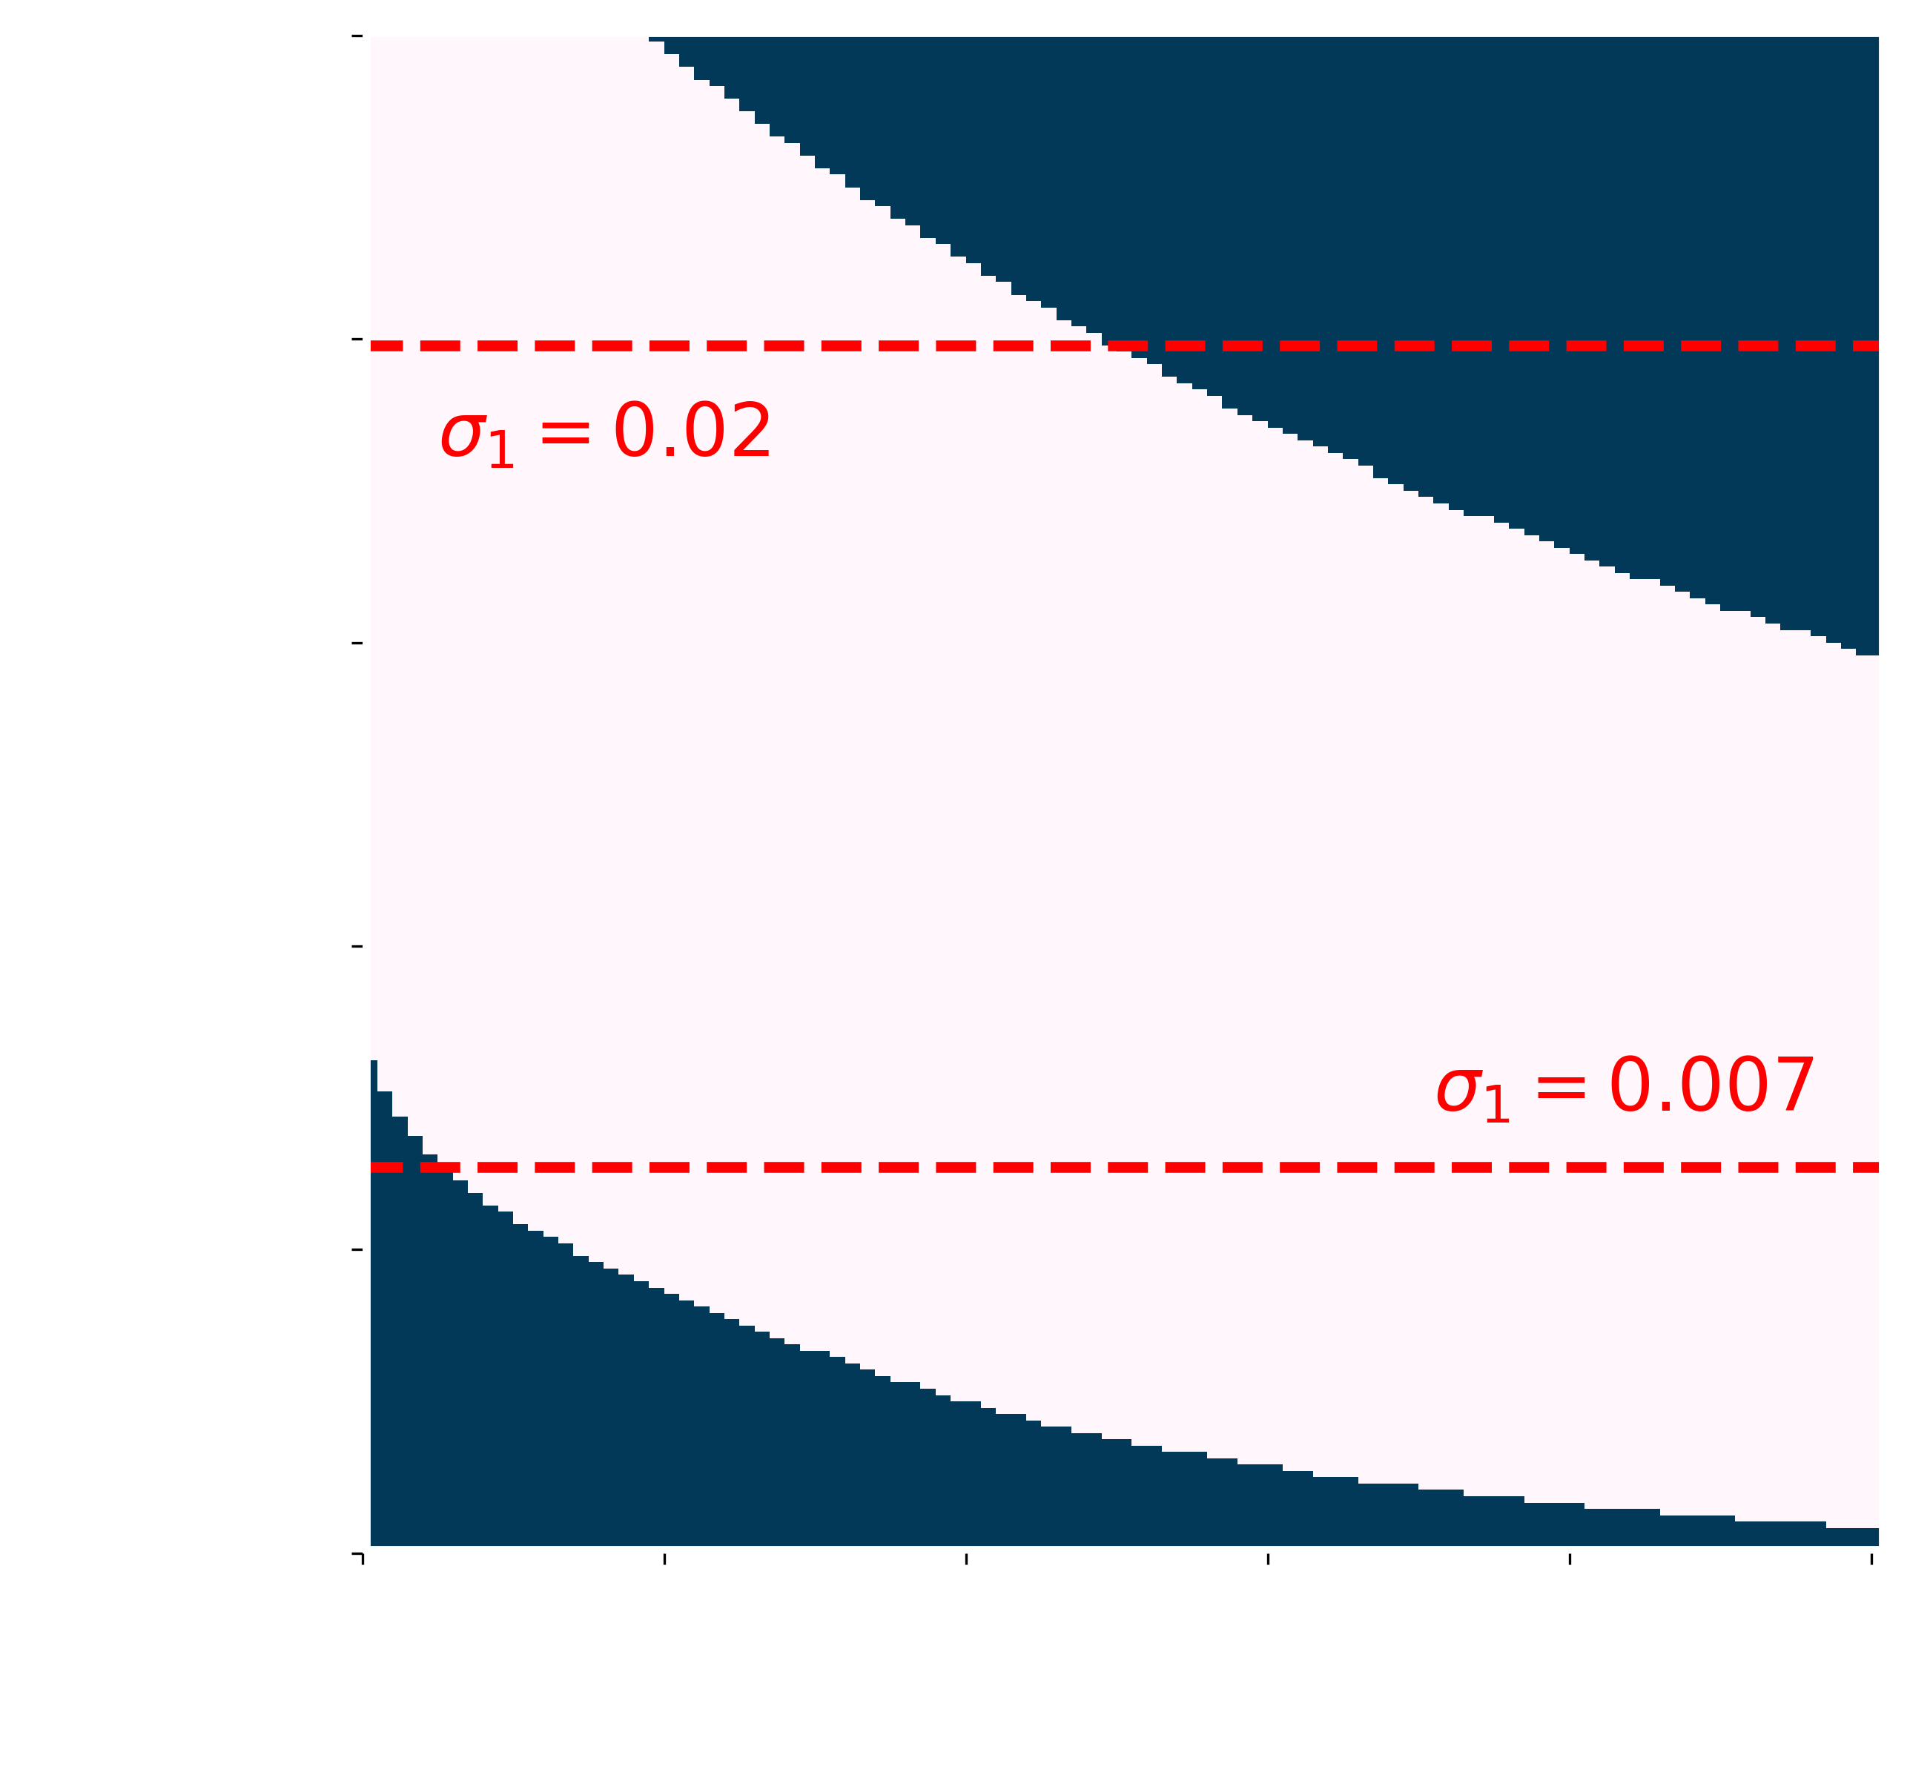
Nonreciprocal interactions can change stability behavior

Slide 25
Nonreciprocal interactions can change stability behavior
Desynchronization

Slide 26
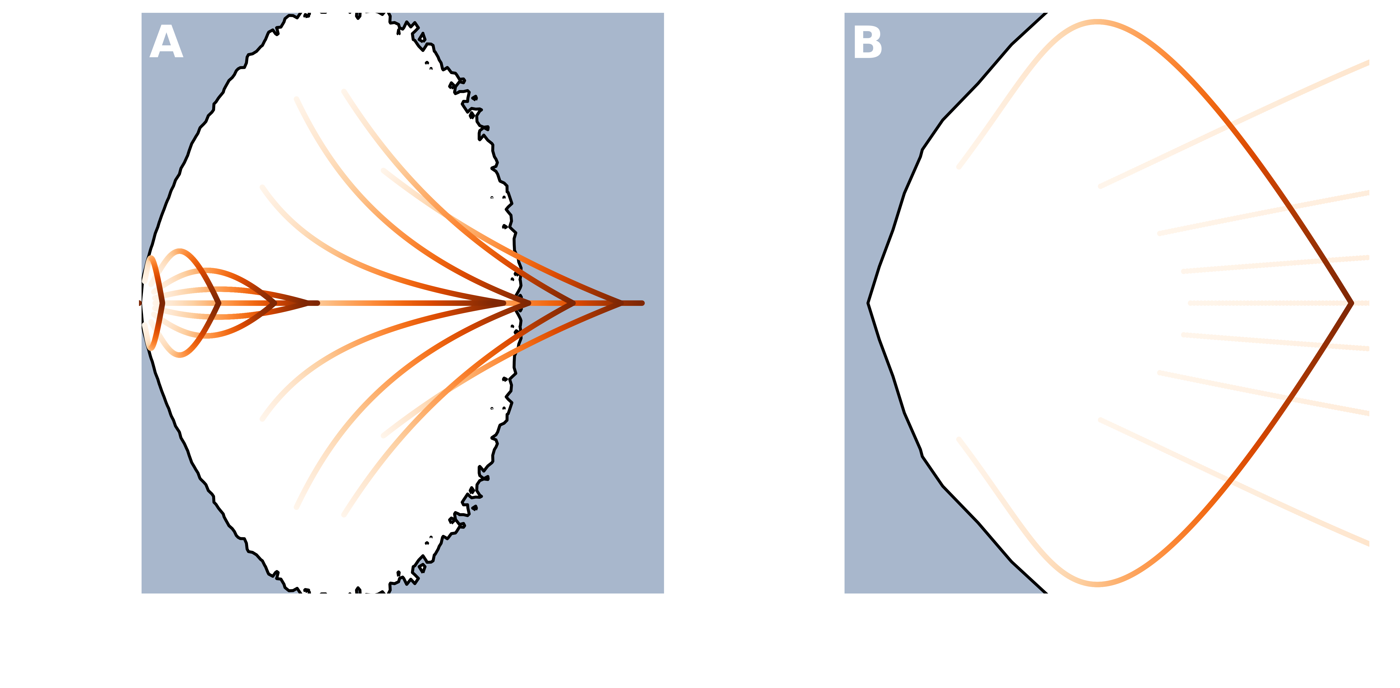
Nonreciprocal interactions can favor synchronization
p=0
p=1

Slide 27
Nonreciprocal interactions can change stability behavior
Synchronization
Desynchronization

Slide 28
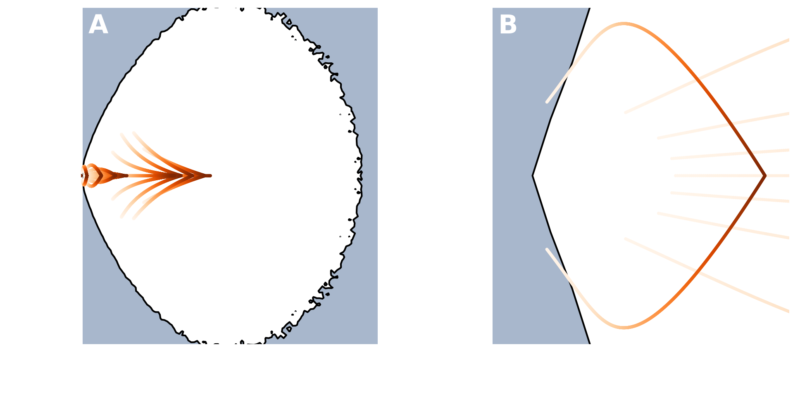
Nonreciprocal interactions can hamper synchronization
p=0
p=1

Slide 29


Conclusion
We have introduced a hypergraph representation to encode nonreciprocal group interactions
Such formalism allowed us to extend the Master Stability Function approach to study synchronization of chaotic oscillators in presence of directed higher-order interactions
We found that the stability of the synchronized state can be lost or gained as directionality in the higher-order structure is varied
Luca Gallo
@l_gajo

